Slide 1
Objectives and functions of aorta
Largest artery
Starts at heart’s left ventricle, arches upwards towards the neck, then curves back downwards.
Usually about 1 inch wide in diameter
Aorta is divided in to 4 parts along length:
Ascending aorta- starting part
Aortic arch- curve upward towards neck and head.
Descending aorta- thoracic aorta
Abdominal aorta- final part of the aorta where aorta splits off into the arteries.
https://www.verywellhealth.com/aorta-anatomy-4588336

Slide 2
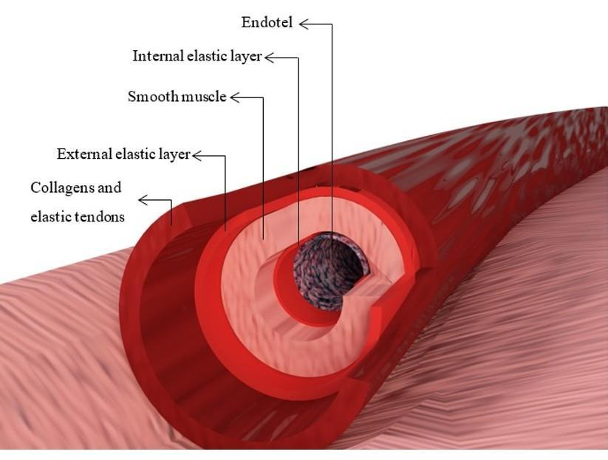
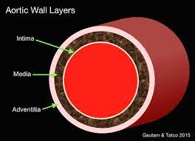
Aorta has three layers in its wall:
Tunica intima- Inner layer ( made up of endothelial cells)
Tunica media- middle layer
Tunica adventitia- outer layer

Slide 3
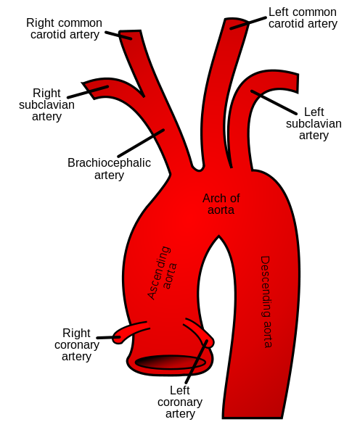
Functions
Ascending aorta: This part of the aorta connects to the aortic valve and it collects oxygenated blood from the left ventricle of the heart. It also gives rise to the left and right coronary arteries which supply blood to the heart.
Aortic arch: This part gives rise to the right common carotid artery and the right subclavian artery (protruding from the brachiocephalic trunk) which supply blood to the right side of the head and neck and the right arm respectively. The left common carotid artery and the left subclavian artery which supply blood to the left side of the head and neck and the left arm respectively also branch off from the aortic arch.

Slide 4
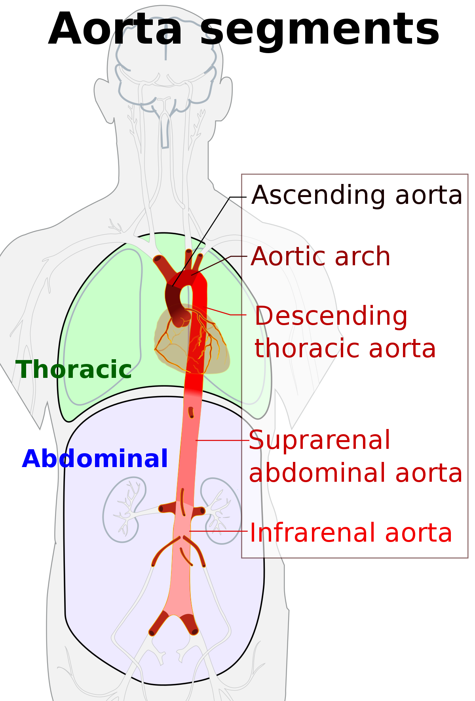
Descending aorta: This part has many smaller arteries branching out from it that supply blood to the esophagus, pericardium, the top part of the diaphragm, lymph nodes, ribs, and some other structures in the chest.
Abdominal aorta: This final part of the aorta gives rise to the largest number of arteries. The arteries branching out from it supply the liver, diaphragm, stomach, spleen, abdominal esophagus, intestines, kidneys, spinal cord, and pancreas. It also gives rise to the iliac arteries which then supply the legs, gluteal muscles, and the organs in the pelvic area.

Slide 5
What happens if the aorta of the heart is damaged?
When the aorta becomes damaged or loses its ability to contract and relax as blood is pumped through it, an aneurysm can develop. An aneurysm is a weakened spot in the walls of the aorta. If it bursts, blood can escape, creating a life-threatening situation. Aneurysms can happen at any point along the aorta.

Slide 6
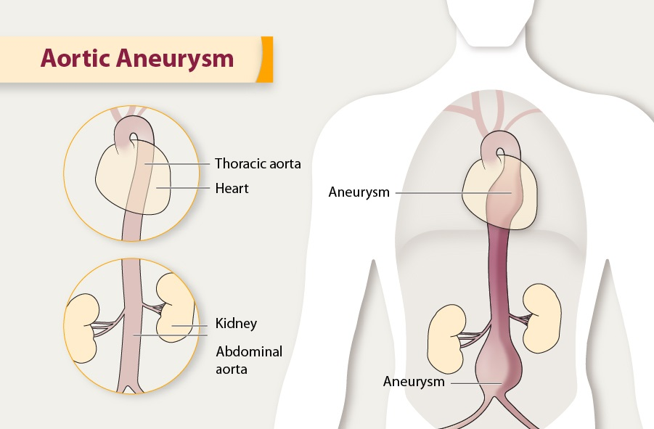
What is aortic aneurysm?
An aortic aneurysm is a balloon-like bulge in the aorta, the large artery that carries blood from the heart through the chest and torso.
Aortic aneurysms can dissect or rupture:
The force of blood pumping can split the layers of the artery wall, allowing blood to leak in between them. This process is called a dissection.
The aneurysm can burst completely, causing bleeding inside the body. This is called a rupture.
Dissections and ruptures are the cause of most deaths from aortic aneurysms.

